Slide 1
Introduction to parasitology
important parasitology terms
By:dr/Nagwa gamal

Slide 2
Introduction
Veterinary parasitology: branch of science that study animal parasites(internal &external ), especially relationships between parasites and animal hosts. Parasites of domestic animals, (livestock and pet animals), wildlife animal ; as well as fish.
Veterinary parasitology study the genesis and development of parasites in animal hosts, as well as the taxonomy and systematics of parasites, including the morphology, life cycles, and living needs of parasites in the environment and in animal hosts

Slide 3
Parasitology divided into:
A)Helminthology : deal with parasitic worms.
B) Protozoology: deal with protozoa{unicellular parasites)
C)Entomology: deal with arthropods{act as vectors&intermedite hosts for parasitic transmission}

Slide 4
Principles of classification:
When examined, living organisms can be seen to form natural groups with features in common.
Taxon: is a group of one or more organisms seen to form a unit
Or groups of organisms are combined into biologically meaningful groups; the study of this aspect of biology is called{ taxonomy}.

Slide 5
The taxa into which organisms may be placed are recognized by
international agreement; the primary ones are kingdom, phylum, class, order, family, genus and species.
For example Haemonchus contortus
Kingdom animalia
Phylum Nematoda
Class Secernentea
Order Strongylida
Suborder Strongylina
Superfamily Trichostrongyloidea
Family Trichostrongylidae
Subfamily Haemonchinae
Genus Haemonchus
Species contortus

Slide 6
The names of the genus and species are expressed in Latin form, the generic name having a capital letter; the species name(lowercase)
For example :Fasciola hepatica

Slide 7
Terminology
Important terms of veterinary parasitology;
(A)Species interaction=association
Types of species interaction:
1-predation(predator-prey):relationship in which the largest \stronger member(predator) benefit while the weak
\smaller(prey) will killed and eated.
2-cannibalism:when an individual eats the dead or living bodies of young individuals of the same species as rodents

Slide 8
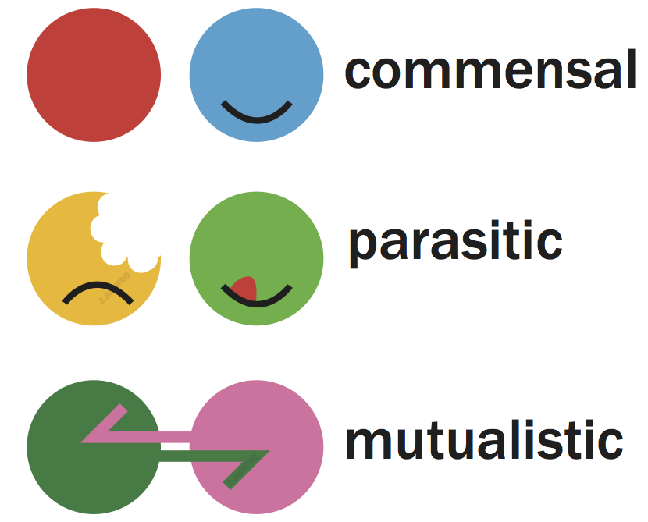
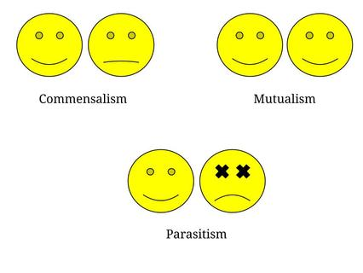
3-symbiosis:refers to any association \close relationship between two different individuals ,it may be temporary or permenant,there are 3 types of symbiotic relationship
1-Mutualism:relation in which two species are benefit from the interaction, so they are unable to live apart
2-commensalism:relation in which one individual benefit while the other individual unaffected.

Slide 9
3-parasitism :Intimate relationship between two
organisms in which one (the parasite) derives benefit from the
other (the host), usually to obtain food ;physical support. Parasitism can have minor or major effects on survival of the host
Types of parasitism\parasites:
1-Endoparasite:parasite live inside the body of the host as nematode;cestode
2-Ectoparasite:parasite live on the surface of host(outside) or live in the skin(mange)

Slide 10
3-facultative parasite: parasite that free living normally; but may parasitic on certain host according to environmental condition as
4-obligatory parasite: parasite that can’t live free living\ separated from it’s host as
5-temporary parasite(intermittent parasite):parasite that contact it’s host only for feed then leave it as mosquitoes
6-permenant parasite: parasite that spend whole or great part of it’s live on the host.
7-Accidental parasite :parasite that enter host other than it’s normal host

Slide 11
8-Ectopic\Erratic\ Aberrant: parasite that found in abnormal habitat as fasciola
9-pseudoparasite:objects that present in feces that may be
mistaken for parasitic stage.
(B)Habitat:it’s the site(tissue , organ , part of host)where the parasite normally found.
(C) Host: where parasite harbors ,it provide the environment essential for development &multiplication of parasite ;it may be (animal ,human ,bird,fish,plant,snail or arthropods)

Slide 12
Types of hosts:
1-final hosts or definitive hosts,: host within which the sexual cycle develop (protozoa) or the adult mature stage of parasite occur(helminthes) mostly only a single type of final hosts occurs (e.g. carnivores).
2-Intremediate host: host within which only an asexual reproduction of a multihost parasite occurs (protozoa)or immature(larval) stage of helminthes develop.
It may be one intermediate host as fasciola while other need several IM as Heteophyes heterophyes
1st pirenella conica snail 2nd tilapia&mugil fish
**It may be vertebrate or invertebrate

Slide 13
3-Transport hosts (=paratenic hosts) :are intermediate hosts, wherein which no reproduction of an included parasite occurs but only a transformation to reach infectivity, it not essential for completion of life cycle .
4-accidental host : unusual host for the parasite
5-reservoir host: susceptible host other than normal definitive host, they are not effected by parasitic infection For example, dogs and rodents may act as reservoir host for stages of the Leishmania species.
6-vector:they are usually arthropods(flies,ticks,mite,mosquitoes)
They transmit parasite to host
It may be a)biological : parasite multiply or develop in it
b)mechanical: parasite not multiply or develop in it

Slide 14
(D) Prepatent period:
The time taken for development from infection until mature adult parasites are producing eggs or larvae.
(E) hypobiosis=Arrested larval development
This phenomenon may be defined as the temporary cessation in development of a nematode at a precise point in it’s parasitic development.

